Slide 1
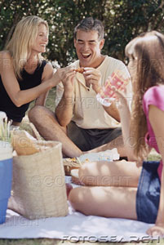
Paired Discussion
What occasions do you share food with others?
Why do you share meals with others?
What type of food do you share?

Slide 2
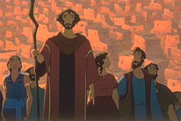
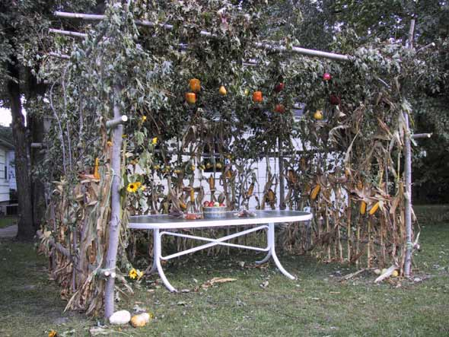
What is the Jewish Festival of Sukkot?

Slide 3
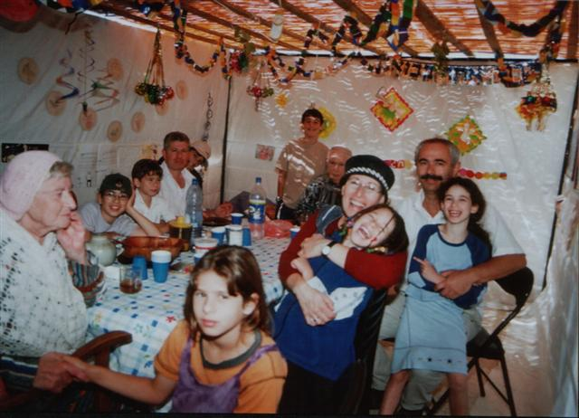
What is the Jewish Festival of Sukkot?
Jewish people celebrate the festival of Sukkot by building a Sukkah in their garden and inviting family and friends for a meal inside.
Why do you think they do this?

Slide 4
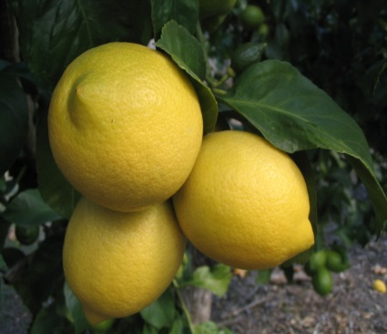
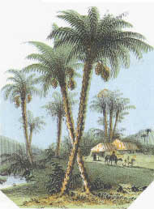
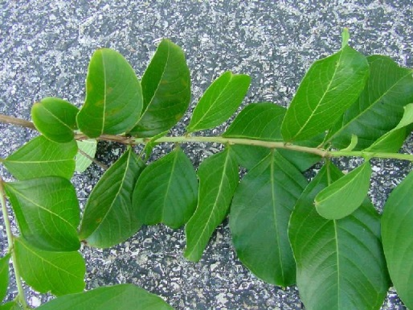
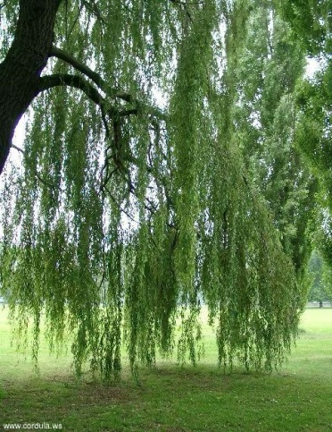
What is the Jewish Festival of Sukkot?
The Sukkah is decorated with lemons, date palms, myrtle leaves and willow branches. Each represents parts of the body.
Can you guess which part of the body?

Slide 5
Challenge
To make a model of a Sukkah
And decorate.

