Slide 1
Quality Marking
Using Driver Words to inform the Next Steps

Slide 2
Setting clear objectives
make sure children know the success criteria from the onset
I can or Can I statements...
the big question

Slide 3
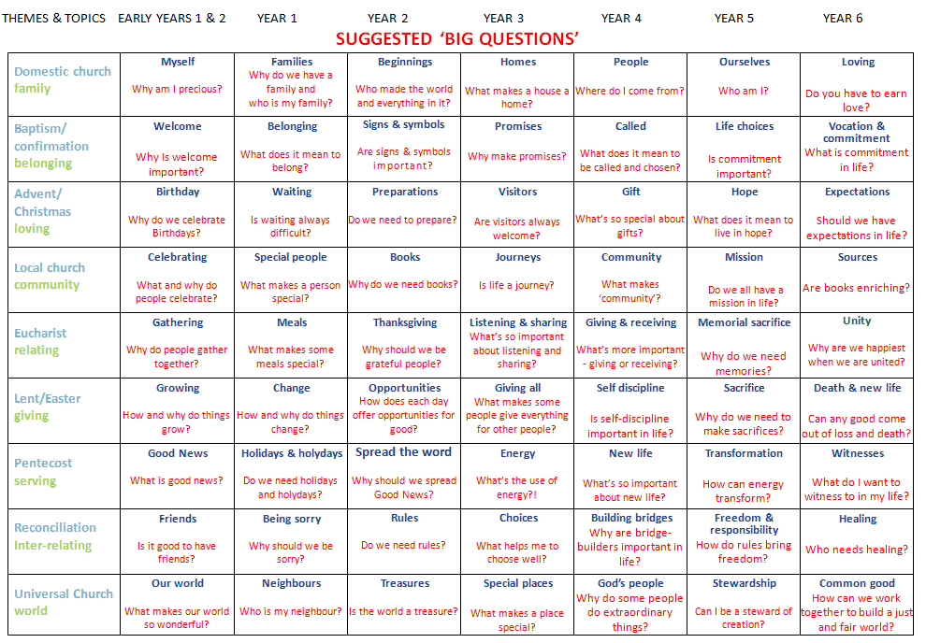

Slide 4
Make the marking count!
Explore
boosting self-esteem
related to objective set
questions to challenge thinking
Notes:
Stickers/smilies/team points etc are a good motivation strategy
quality marking ensures quality learning
Be realistic – do not mark every piece of work
Must mark Explore and Reveal aspect of the topic
Must be marked according to the criteria/objectives set WALT/WILF etc
Pose questions to challenge thinking using the language of the level descriptors (back to driver words)
Inform of next steps...
Time to respond to marking

Slide 5
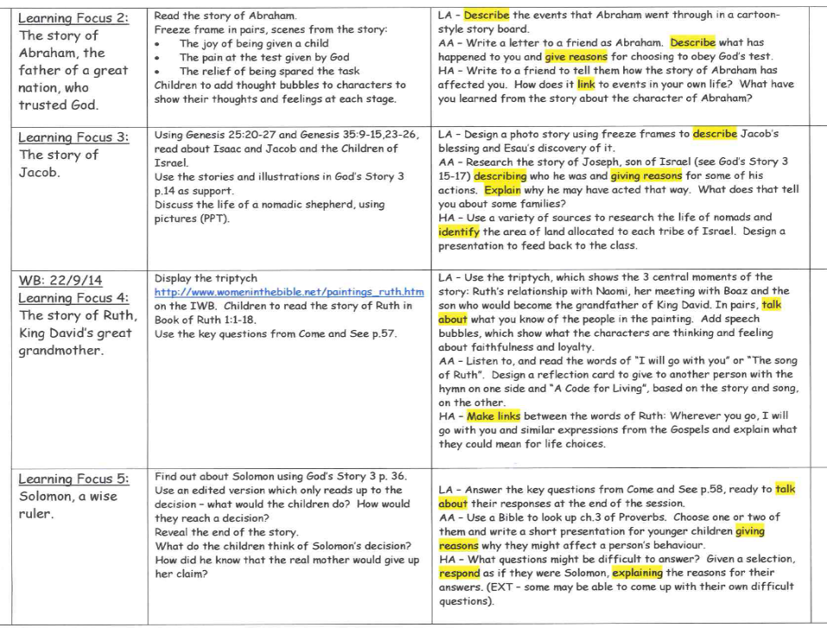

Slide 6
Driver words
 | AT1 - learning about | AT2 - learning from
L1 | Recognise | Talk about
L2 | Describe | Ask
L3 | Give reasons | Make links
L4 | Show understanding | Engage and respond
L5 | Identify and explain | Explain

Slide 7
ATTAINMENT TARGET 1 : Learning about Religion
(Knowledge, Skills and Understanding)
AT 2 : Learning from Religion
(Questions and Responses)
 | (i) beliefs, teachings and sources |  | ii) celebration and ritual |  | iii) social and moral practices and way of life |  | i) engagement with own and others’ beliefs and values |  | ii) engagement with questions of meaning and purpose
 | CHURCH THEME |  | SACRAMENTAL THEME |  | CHRISTIAN LIVING THEME
1 | Recognise some religious stories |  | Recognise some religious signs and symbols and use some religious words and phrases |  | Recognise that people because of their religion act in a particular way |  | Talk about their own experiences and feelings |  | Say what they wonder about
2 | Retell some special stories about religious events and people |  | Use religious words and phrases to describe some religious actions and symbols |  | Describe some ways in which religion is lived out by believers |  | Ask and respond to questions about their own and others’ experiences and feelings |  | Ask questions about what they and others wonder about and realise that some of these questions are difficult to answer
3 | Make links between religious stories and beliefs |  | Use a developing religious vocabulary to give reasons for religious actions and symbols |  | Give reasons for certain actions by believers |  | Make links to show how feelings and beliefs affect their behaviour and that of others |  | Compare their own and other people’s ideas about questions that are difficult to answer
4 | Describe and show understanding of religious sources, beliefs, ideas, feelings and experiences; making links between them |  | Use religious terms to show an understanding of different liturgies |  | Show understanding of how religious belief shapes life |  | Show an understanding of how own and others’ decisions are informed by beliefs and values |  | Engage with and respond to questions of life in the light of religious teaching
5 | Identify sources of religious belief and explain how distinctive religious beliefs arise |  | Describe and explain the meaning and purpose of a variety of forms of worship |  | Identify similarities and differences between peoples’ responses to social and moral issues because of their beliefs |  | Explain what beliefs and values inspire and influence them and others |  | Demonstrate how religious beliefs and teaching give some explanation of the purpose and meaning of human life
These are covered throughout the process. EXPLORE > REVEAL > RESPOND

Slide 8
Driver words!
Recognise
Talk about
Level 1
Describe
Ask
Level 2
Give reasons
Make links
Level 3

Slide 9
Higher Levels
Show understanding
Engage and respond
Level 4
Identify
Explain
Level 5

Slide 10
Make the marking count!
Reveal
don’t be unrealistic
related to objective set
questions to challenge thinking
next steps using Driver Words
Notes:
Stickers/smilies/team points etc are a good motivation strategy
quality marking ensures quality learning
Be realistic – do not mark every piece of work
Must mark Explore and Reveal aspect of the topic
Must be marked according to the criteria/objectives set WALT/WILF etc
Pose questions to challenge thinking using the language of the level descriptors (back to driver words)
Inform of next steps...
Time to respond to marking

Slide 11
Other ways to mark work
verbal feedback (VF)
self assessment
peer assessment

Slide 12
Evidencing work
(A) or (LOA) needs qualifying...
take photographs and stick them into the books i.e. continuous provision
use a learning receipt to show that something practical was going on i.e role play, drama, visit to church etc

Slide 13
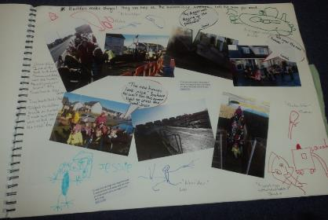
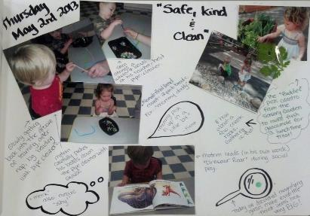
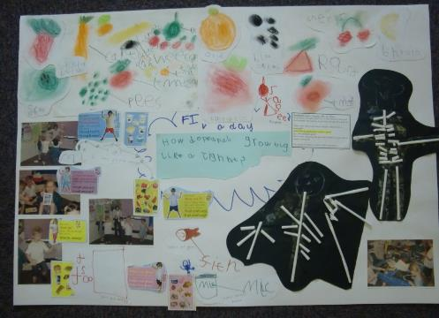
Early Years – Floor books

Slide 14
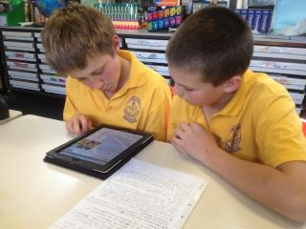
Technology
ipads - ebooks
- imovies

Slide 15
Year 2 - Learning Focus 1
You retold the story of the Last Supper very well Laura.
Can you describe how the disciples
felt?
Simply use the driver word from your
objective in your marking...

Slide 16
Simply use the driver word from your learning objective in your marking...
LA I can retell the story of the Last Supper (sequencing)
You have retold the story of the Last Supper very well Laura.
Can you describe how Jesus’ friends felt at the Last Supper?
MA I can retell the story of the Last Supper (written)
You have retold the story very well.
Can you now try and make a link to what Fr. John says in Mass about the Last Supper?
HA I can describe how the disciples felt at the Last Supper (written)
Well done Tom, you have described how the disciples felt at the Last Supper.
Can you make a link to what we say and remember at Mass? Furthering and challenging to Level 3
Well done Sam, you have described the events well.
3 new ,,,
2 interesting ,,,
1 more ,,,
(i) beliefs, teachings and sources
CHURCH THEME
Recognise some religious stories
Retell some special stories about religious events and people
Make links between religious stories and beliefs
Describe and show understanding of religious sources, beliefs, ideas, feelings and experiences; making links between them
Identify sources of religious belief and explain how distinctive religious beliefs arise
Expanding Level 2
Furthering and challenging to Level 3
Assessing own learning
Notes:
Futhering

Slide 17
Year 2 – Learning Focus 2
Next time try and make a link to
what Fr. John says to the Last
Supper.
Use a different coloured pen to ask a
question which requires a response...
Give me a reason why you choose
those words?

Slide 18
Year 3 - Learning Focus 3
or (LOA) needs qualifying...
Emma you have begun to make links
between what Jesus said and how
Christians should live.
Can you give me a reason why?

Slide 19
Year 4 - Learning Focus 5
Can you describe what is happening in your role play?
Philip, can you give me a reason for what you are doing?

Slide 20
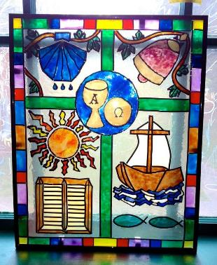
Year 6 - Learning Focus 4
Wow! What a fabulous
design Zak. I can clearly recognise some Christian symbols.
Can you give reasons
for your choices to show you understand how Christians are united.

