Slide 1
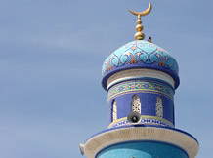
Welcome to our presentation about ISLAM

Slide 2
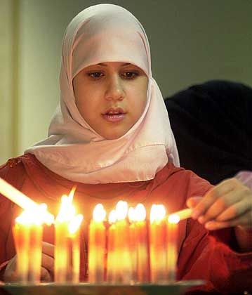
Islam is the religion of people called Muslims.
Muslims believe that someone is more important than themselves and they obey him. Muslims believe this person is God, whom they call Allah.
Muslims believe that there is just one God and he is eternal.

Slide 3
There are over 1.2 billion Muslims in the world today, living in almost every country in the world.
About 3 million Muslims live in the USA, about 1.5 million live in Britain.
In most of the countries in northern Africa and the Middle East, over half of the population are Muslims.
Islam is the world’s second largest religion after Christianity.

Slide 4

Islam ~ how did it start?
The special person for Muslims is Muhammad
He was born in Mecca in the year 570 and was buried in the city of Medina
He used to pray in a cave on Mount Hira
When he was 40 years old Muslims believe that he received his first message from God from an angel
He began to preach these messages to other people and the religion of Islam began
Later, these messages were written down in the Muslim’s holy book called the Qur’an
It was written in Arabic

Slide 5

Islam ~ practises
The Muslim holy day is…?
Friday
Their place of worship is called…?
A Mosque
The Muslim religious leader is called…?
The ‘Imam’
The moon and star is a symbol often used on flags and buildings of Islamic countries
It goes back to the days when the Arabs travelled by night using the moon and stars for directions as it was too hot in the desert by day!

Slide 6
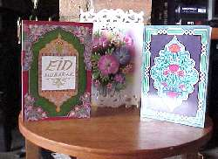
Festival of Eid ul-Fitr
At the end of Ramadam which is the thirty day fast there are a huge celebration. Everyone dresses in their best clothes. They go to the mosque to pray together. Special celebration meals are served up.
Everyone has a holiday and many big family groups of relations all get together.
Children are given sweets, presents and often new clothes. Muslims send cards to each other to celebrate this special time. They often make offerings to the poor and sometimes buy each other presents.

Slide 7
The Five Pillars of Islam
Muslim people have five duties which are called the Five Pillars of Islam. Every Muslim tries to carry out these five things, and it helps them to feel that they are members of the worldwide Muslim community.

Slide 8
Pillar 1: SHAHADAH
This Pillar is believing and saying the words. “There is no god except Allah, Muhammad is the messenger of Allah”.
Muslims say this when they are praying

Slide 9
Pillar 2:SALAH
This Pillar is praying five times a day. There are set prayers which Muslims should say, and all Muslims should face Mecca in Arabia when praying, and should pray on a prayer mat. People should wash before they pray. There are fixed movements, which include kneeling with the forehead placed on the ground in front. This expresses the servant status of the human being in relation to Allah.

Slide 10
Pillar 3: ZAKAH
Each year, Muslims are supposed to give a some of their savings for charity such as helping the poor. In this way, they believe that their wealth is “made pure”

Slide 11
Pillar 4: SAWM
Muslim people must not eat food and drink during the month of Ramadan during daylight hours.

Slide 12
Pillar 5: HAJJ
This is making a pilgrimage to Mecca at least once in your life, if it can be afforded.

Slide 13
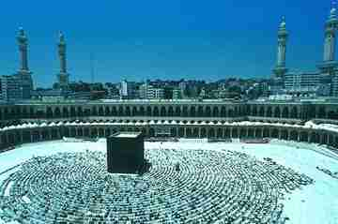
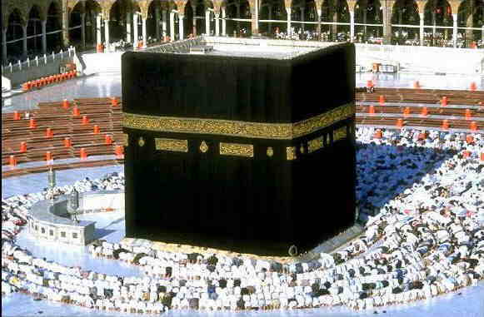
Islam ~ places of prayer
The shrine at Mecca…
Where Muhammad destroyed the idols
Muslims try to come here once in their lifetime. It is the holiest place of all for Muslims
In Saudi Arabia…

Slide 14
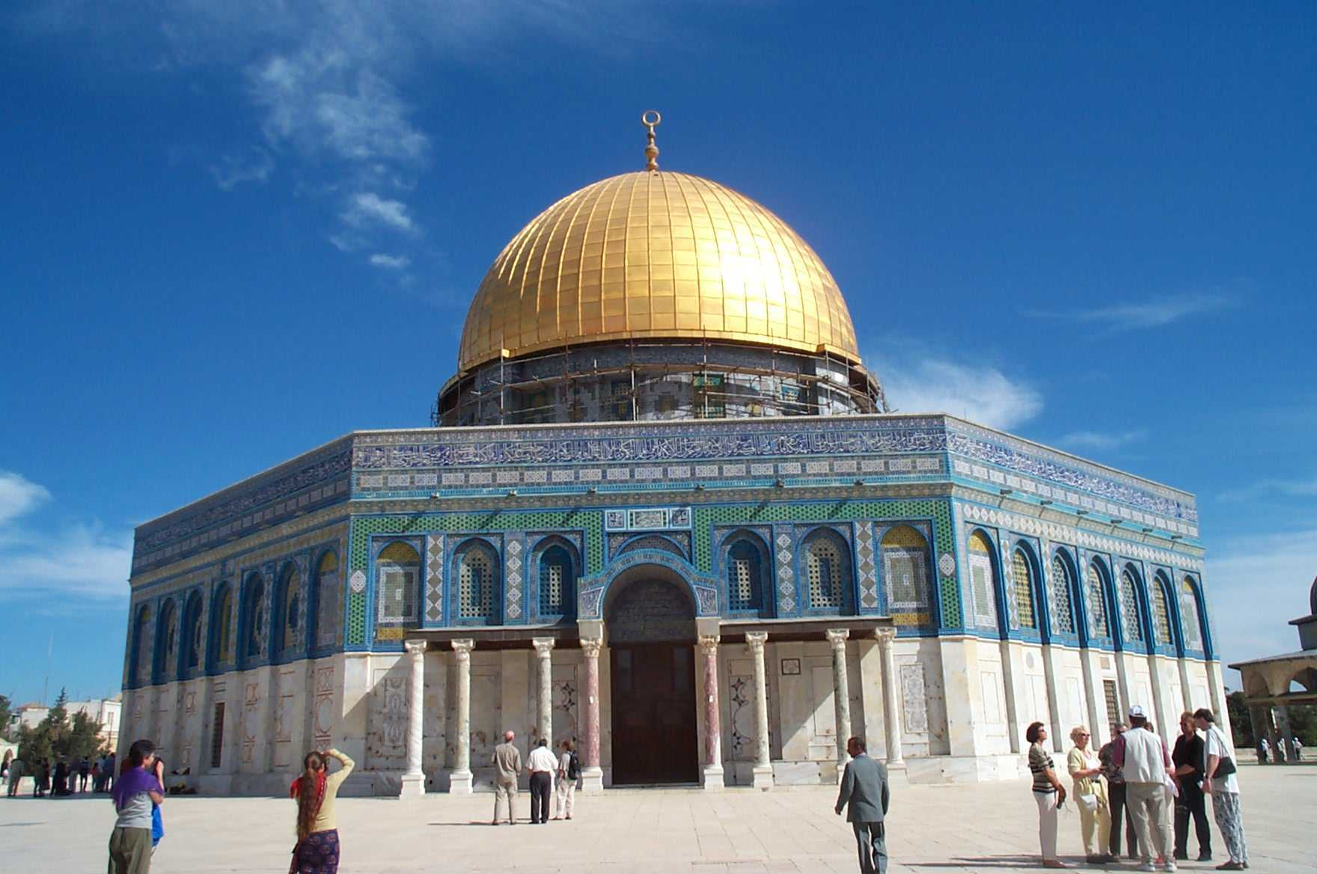
Islam ~ The Mosque
Sometimes known as the ‘Dome on the Rock’…
Where Muslims believe Muhammad went up to heaven
The Al-Aksa mosque in Jerusalem

Slide 15
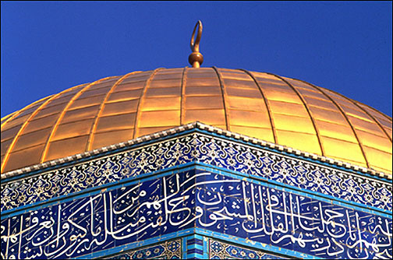
The Mosque
At a mosque there are no pictures or statues, only beautiful patterns and verses from the Qu’ran…
why?

Slide 16
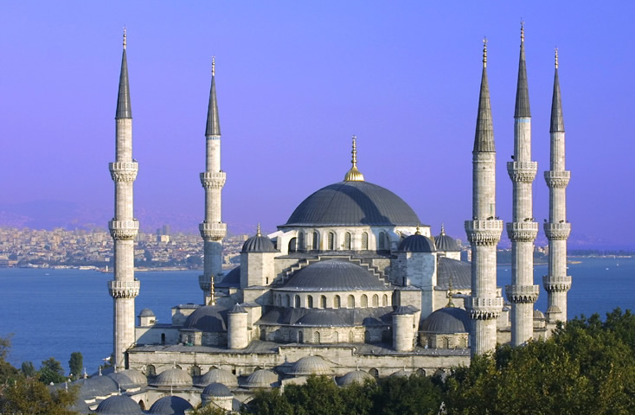
The famous Blue Mosque
400 years old...

Slide 17
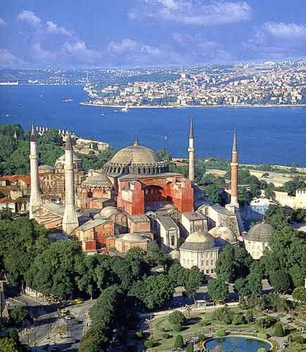
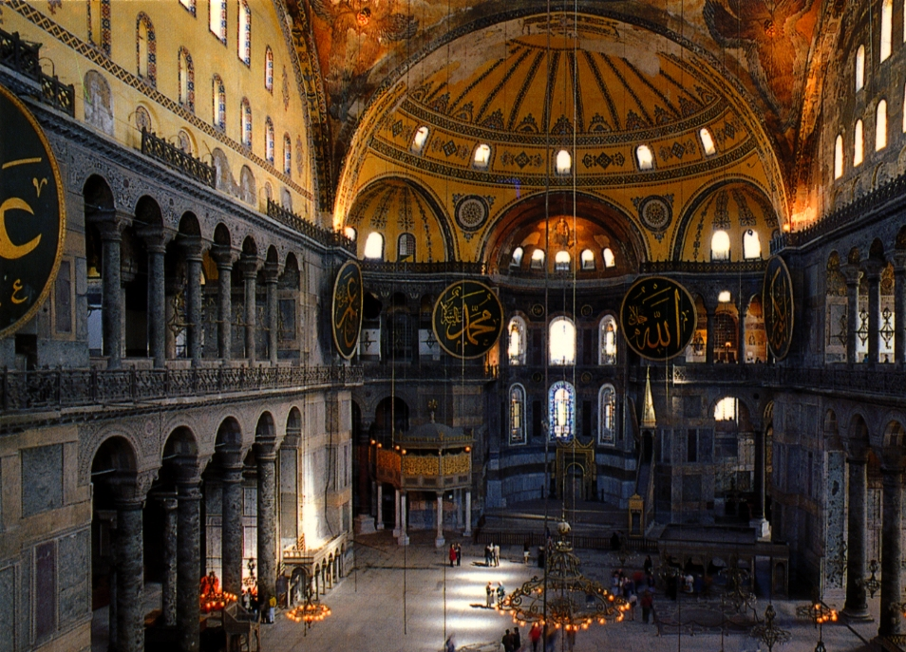
Hagia Sophia
1,500 years old!

Slide 18
Can you remember?
How many pillars do Muslims try to act upon?
What is the Muslim word for God?
Who do Muslims believe was the last messenger of God?
How many times each day should Muslims pray?
What language do Muslims use during prayer?
In which direction do Muslims face when they pray?
During which month do Muslims fast?
Where do Muslims go on pilgrimage?
That's all for now!

